Slide 1
Multiple Alignment
Jack Leunissen
Wageningen University

Slide 2
Multiple Alignment
The purpose of a multiple alignment is to line up all residues that were derived from the same residue position in the ancestral gene or protein in any number of sequences

Slide 3
Multiple Alignment
The purpose of a multiple alignment is to line up all residues that were derived from the same residue position in the ancestral gene or protein in any number of sequences
gap = insertion or deletion

Slide 4
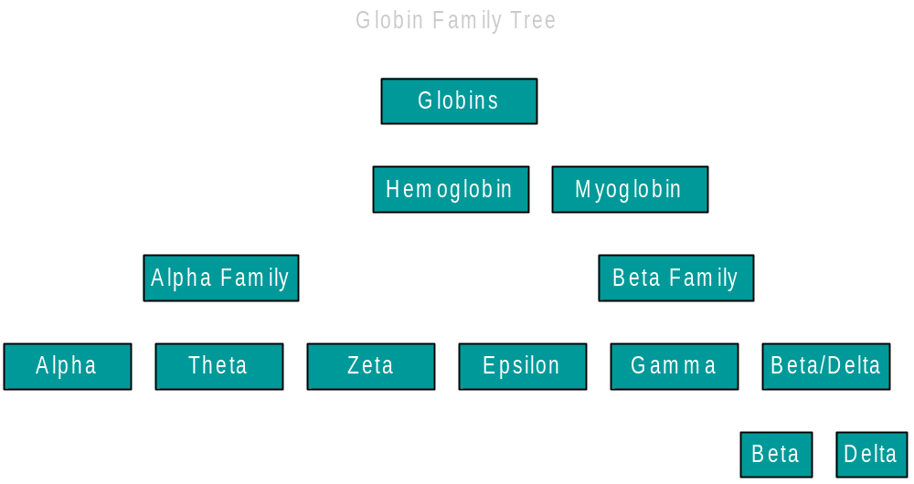
Hierarchy Of Alignments

Slide 5
From Pairwise To Multiple
Two sequences
Three sequences

Slide 6
And Beyond ...
Assuming that it takes 1 kilobyte (1kb) to store one single sequence, then ...
To do simultaneous alignment it takes for
  2 sequences : 1 megabyte of memory
  3 sequences : 1 gigabyte of memory
  4 sequences : 1 terabyte of memory
  5 sequences : 1 petabyte of memory
  6 sequences : 1 exabyte of memory

Slide 7
Iterative Approach
First do all the easy alignments
Then gradually add all the difficult ones
But how do we know what alignments are easy of difficult?

Slide 8
Iterative Algorithm
as applied in ClustalW and similar programs
Do a pairwise comparison of all sequences
From this, calculate how sequences are related to each other (the more similar are easier to align)
Perform multiple alignment in order; the most similar are aligned first, the others are saved for later

Slide 9
1: Pairwise Comparison
Compare every single sequence to every other sequence, using pairwise sequence alignment
      seq_1 & seq_ 2 ⇒ 0.91
      seq_ 1 & seq_ 3 ⇒ 0.23
      …
      seq_ 8 & seq_ 9 ⇒ 0.87
Record the resulting similarity scores

Slide 10
2: Calculate The Guide Tree
Construct a guide tree from the matrix containing the pairwise comparison values, using a clustering algorithm
  UPGMA (PileUp & Clustal V)
  Neighbor-Joining (Clustal W, Clustal X)

Slide 11
How UPGMA Works ...
A
C
4
3
2
2
2
3
D
B
1
E

Slide 12
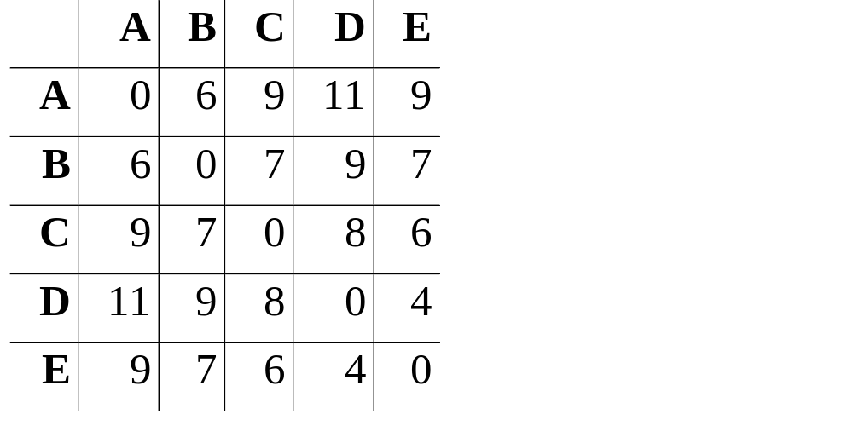
UPGMA - Step 1
D
E

Slide 13
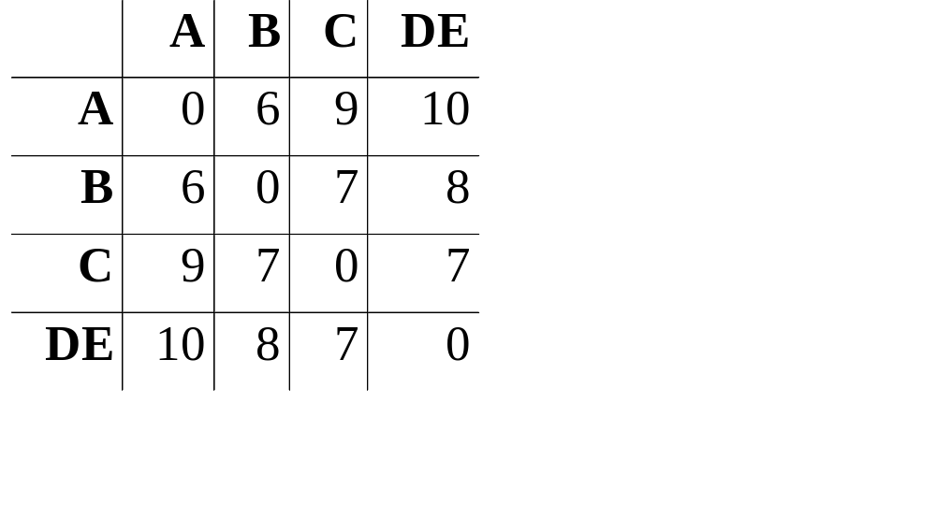
UPGMA - Step 2
D
E
A
B

Slide 14
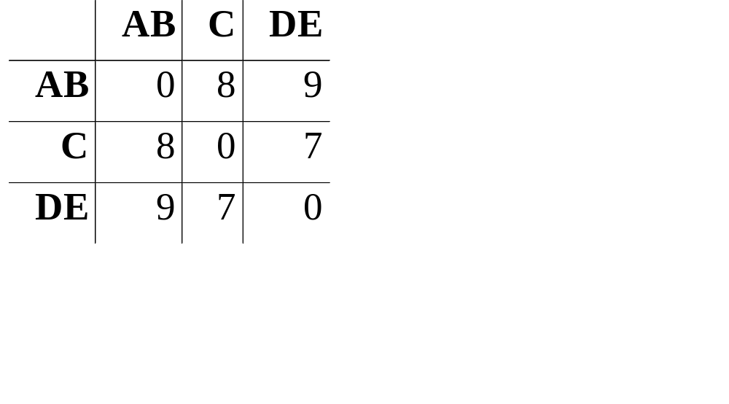
UPGMA - Step 3
C
D
E
A
B

Slide 15
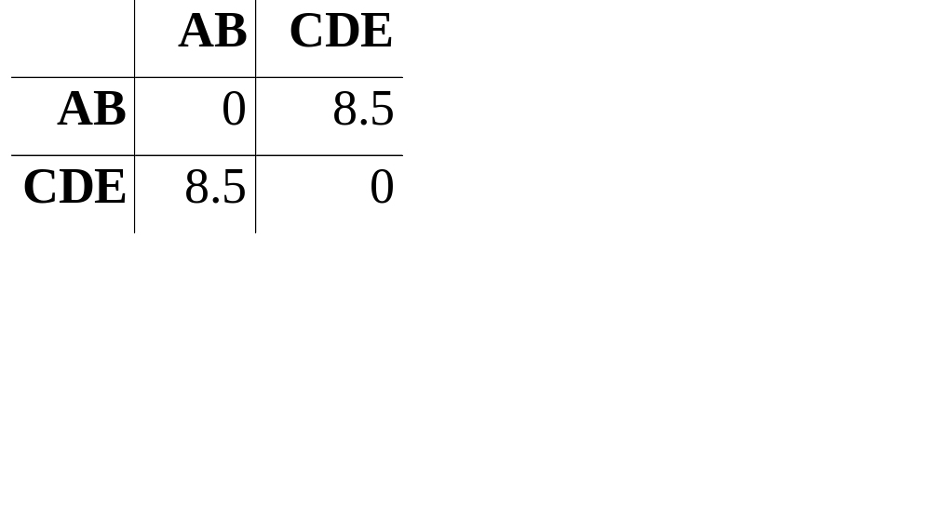
UPGMA - Step 4
C
D
E
A
B

Slide 16
3: Multiple Alignment
Using the guide tree, we start aligning groups of sequences
The purpose of the guide tree is to know which sequences are most alike; so we can align the “easy” ones first, and postpone the tricky ones to later in the procedure!

Slide 17
Input: Unaligned Sequences
a mthislgslyshktaktingsdeaskmewhf
b mthvslgsmyshktgrtingsdqaskkmewhy
c mshisitmyshktartidgseqaskmewhy
d mthipigsmyshktaravngseqasklqwhy
e mthipigsmystartincseqasklewhy

Slide 18
Multiple Alignment
C
D
mthipigsmyshktaravngseqasklqwhy
mthipigsmys--tartincseqasklewhy
E
A
B

Slide 19
Multiple Alignment
C
D
mthipigsmyshktaravngseqasklqwhy
mthipigsmys--tartincseqasklewhy
E
A
mthislgslyshktaktingsdeas-kmewhf
mthvslgsmyshktgrtingsdqaskkmewhy
B

Slide 20
Multiple Alignment
C
mshisi-tmyshktartidgseqaskmewhy
mthipigsmyshktaravngseqasklqwhy
mthipigsmys--tartincseqasklewhy
D
E
A
mthislgslyshktaktingsdeas-kmewhf
mthvslgsmyshktgrtingsdqaskkmewhy
B

Slide 21
Multiple Alignment
C
mshisi-tmyshktartidgseqas-kmewhy
mthipigsmyshktaravngseqas-klqwhy
mthipigsmys--tartincseqas-klewhy
D
E
A
mthislgslyshktaktingsdeas-kmewhf
mthvslgsmyshktgrtingsdqaskkmewhy
B

Slide 22
Output: Aligned Sequences
a mthislgslyshktaktingsdeas-kmewhf
b mthvslgsmyshktgrtingsdqaskkmewhy
c mshisi-tmyshktartidgseqas-kmewhy
d mthipigsmyshktaravngseqas-klqwhy
e mthipigsmys--tartincseqas-klewhy

Slide 23
GSSQVRAHGQ KVADALSL-A ERLDDLPHAL SALSHLHA-Q LRVDPASFQL
GSAQLRAHGS KVVAAVGD-A KSIDDI--AL SKLSELHAYI LRVDPVNFKL
GSAQVKGHGK KVADALTN-A AHVDDMPNAL SALSDLHAHK LRVDPVNFKL
PDAVMGNPKV KAHGKKVLGA FSDGLAHLDN LKGTFATLSE LHCDKLHVDP
PDAVMGNPKV KAH-KKVLGA FSDGLAHLDN LKGTFS-LSE LHCDKLHVDP

Slide 24
Things To Remember ...
All multiple alignment programs are GLOBAL alignment programs
The guide tree is NOT the phylogenetic tree

Slide 25
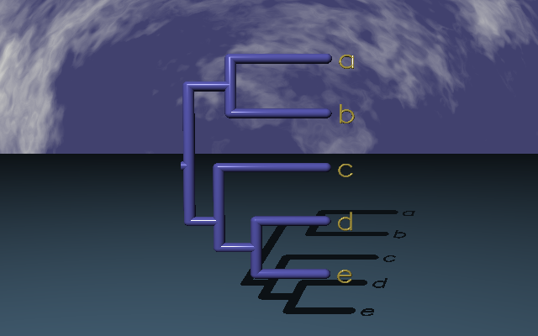
… no matter how beautiful it looks!

Slide 26
Things To Remember ...
All multiple alignment programs are GLOBAL alignment programs
The guide tree is NOT the phylogenetic tree
A multiple alignment program is the starting point, not the end point of producing a good, meaningful alignment

Slide 27
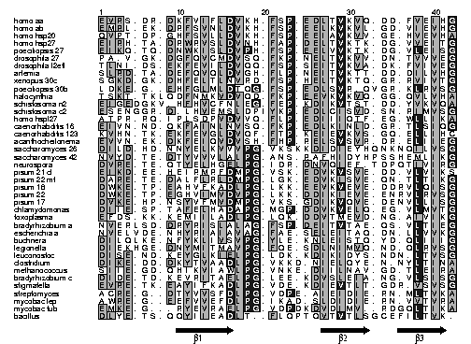

Slide 28
How UPGMA Works ...
A
C
4
3
2
2
2
3
D
B
1
E

Slide 29
How UPGMA Works ...
Badly
A
C
3
3.5
2
1.5
3
2
D
B
2
E

Slide 30
Running PileUp
Sequences must be in GCG format, either in separate files (using a file-of-filenames) or in an existing MSF or RSF file
Suppress the tree output (option C), since it is of no use!
...

Slide 31
Running Clustal W
Input can be in either Clustal, EMBL, PIR, Fasta or GCG (MSF) format
Clustal can align individual sequences as well as existing alignments

Slide 32
wombat KFTGLTQEELLTLLQQMIKYQVLEGNVGYLRVDYIPGQEVVEKVGEFLVNDVWKKLMGTSSLVLDLQHSTGGEVSGIPFVISYLHQGDNLLHVDTVYDRP
opossum KFANVTQEELLTLLQQMIKYQVLEGNVGYLRVDYIPGQEVVEKVGEFLVNNIWKKLMGTSALVLDLQHSSGGEVSGIPFVISYLHQGDIVLHIDTVYDRP
3t_sloth XXNNLTQDKLLTRLQKDIHSEVLEGNVAYLRVDDILGQEQMSQLGGILGAEAWKELTKTSALVLDLRHCTGGHVSGIPYIVSYLHPGNSVLHVDTIYNRP
Af_elepha APTNLTEEEMLSELQTSMSYKVLEGNVGYLRVDNIPGQEVLNQLGAFLVTHVWKQLMGSSALVLDLRHCTGGHVSSIPYLISYLHPGGTVLHVDTIYNRP
dugong APTNLTQEELLSELQTSMSYKVLDGNVGYLRVDNIPGQEVLSRLGGFLVTHIWKQLMGSSALVLDLRHCMGGHVSSIPYIISYLHPGGAVLHVDTIYNRP
hyrax APTNLTQEELLSELQTSMSYKVLEGNVGYLRVDNIPGQDVLNQLGGFLVTHVWKQLMGSSALVLDLRHCTGGHVSSIPYLISYLHPGSTVLHVDTIYNRP
aardvark TPANLTQEELLSELQRSMSYQVLEGNVGYLRVDSIPGQEVLSQLEDFLVPHVWRQLMGSSALVLDLRYCTGGHVSSIPYFISYLHPGGTVLHVDTIYNRP
el_shrew -PTNLTQEELLSELERSMSYRILDGNVGYLQIDNIPGQEVLSRLGAFLVAHVWRQLMGTSALVLDLRQCTGGHVSSIPYLISYLHPAGTVLHVDTIYNRP
mouse VLTNLTREELLAQIQRNIRHEVLEGNVGYLRVDDLPGQEVLSELGEFLVSHVWRQLMSTSSLVLDLRHCSGGHFSGIPYVISYLHPGNTVMHVDTVYDRP
NA_porcup APTNLSQEELLAGLQKSIRHEVLEGNVGYLRVDDLPSQEVLSRLGTLLMTNVWKQLMGTSALVLDLRQCPSGHVSGIPYI?SYLHPGNTVLHVDTIYNRP
rabbit APSNLTQEELLAWLQKSIQHEILEHNVGYLRVDDLPGQEVLSKLGGFLVAHVWGQLMGTSALVLDLRHCTGGHVSGIPYVISYLHPGNTVVHVDTIYDRP
galago TLTNLTQEELLAWLQRGLRYEVLEGNVGYLRVDDIPGQEVLSKLGAFLVAHVWGKLMGTSALVLDLRHCTGGQVSGIPYVISYLHPGNTILHVDTIYDRP
human ALTSLSEEELLAWLQRGLRHEVLEGNVGYLRVDSVPGQEVLSMMGEFLVAHVWGNLMGTSALVLDLRHCTGGQVSGIPYIISYLHPGNTILHVDTIYNRP
fl_lem AFTNLTQEELLAWLQKGIHHEVLEGNVGYLRVDDLPGQEVLSKLGEFLVAHIWSKLIDTSALVLDLRHCTGGQVSGIPYIISYLHPGNTAVHVDTIYDRP
tr_shrew AFDSLTQEELLTHLQEGIRHEVLEGNVGYLRLDDLPNQEVLNQLGAFLVTHVWMKLMGTSALVLDLRHCTRGHVSGIPYVISYLHPGSTVLHVDTIYNRP
hedgehog ALRNLTQEQLLVQVQKSIHHEILEGNVGYLRMDDIPGQEVVSKLGGFLAASVWTKLMGTSALVLDLRHCTGGHVSGVPYLVSYLHSGNTVLHVDTIYDRP
shrew APSNLTQEELLSELQRAIRYQVLAANVGYLGRDNLPGQEVVTILGALLVANVWGKLIATSPLVLDLRHCTGGHVSGIPYVISYLYPGNTVLHMDTIYDRP
r_ear_bat ALTNLTQEELLAQLQKGIHYDILESNVGYLRVDDIPSQEVVSKLGDFLVANIWRKLLGTSALVLDLRHCTGGHVSGIPYVISYLHPGNTVLHVDTIYDRP
fl_fox ALTHLTQEELLAQLQKGIRHDVLEGNVGYLRVDDIPNQEVVSKLGGFLVENIWRKLMGTSALVLDLRHCTGGHVSGIPYVISYLHPGNTILHVDTIYDRP
pangolin ELTDLTQEELLAQLQKGIHHEVLEGNVGYLRVDNIPGQEVLSELGDFLVAHIWQKLMGTSALVLDLRHCTTGHVSGIPYVISYLHPGNTVLHVDTIYNRP
cat ALTNLTKEEMLARLQKGIRHEVLEGNVGYLRVDDIPSQEVVSKLGGFLVASVWRKLMGTSALVLDLRHCTGGHVSGIPYVISYLHPGNTVLHVDTIYDRP
fox ALTNLTREELLARLQKGIRHEVLEGNVGYLRVDDIPGQEVVDKLGSFLVASIWRKLMGTSALVLDLRHCTGGHISGIPYVVSYLHPGNTVLHVDTIYDRP
tapir ALTDLTPEELLARLQKDIRHDILEGNVGYLRVDDIPGQEVVSKLGDFLVANIWRKLLDTSALVLDLRHCTGGHVSGIPYIISYLHPGNTVLHVDTIYDRP
horse ALTNLTQEELLARLQEGIRYDILEGDVGYLRVDNIPGQEVVSKLGGFLVDNVWRKLMGTSALVLDLRHCTGGHVSGIPYIISYLHPGNTVLHVDTIYDRP
mi_whal ALMNLTLEELIAGLQNGLRHEVLEGNVGYLRVDDIPGQEVMSKLRSFLVANVWRKLMGTSALVLDLRHCTGGQISGIPYVISYLHPGNTVLHVDTIYDRP
hippo ALKNLTLEELIAGLQNGLHHEVLEGNVGYLRVDDIPGQEVMSKLRSFLVANVWRKLMGTSALVLDLRHCTGGRISGIPYVISYLHPGNTVLHVDTIYDRP
cow AVTNLTLEEIIAGLQDGLRHEILEGNVGYLRVDDIPGQEVMSKLRSFLVANVWRKLVNTSALVLDLRHCTGGHVSGIPYVISYLHPGSTVSHVDTVYDRP
pig ALRNLTLEELIEGLHNSLRHEVLEGNVGYLRVDDIPGQEVMNKLGSFLVVNVWEKLMGTSALVLDLRHCTRGHVSGIPYVISYLHPGNTVLHVDTIYDRP

Slide 33
hom_aa EVRS-DR-DK FVIFLDVKH- FSP-EDLTVK VQ-DD-FVEI HG----KHNE R-QDD---HG --Y--IS-R- ---EFHRRYR
hom_ab EMRL-EK-DR FSVNLDVKH- FSP-EELKVK VL-GD-VIEV HG----KHEE R-QDE---HG --F--IS-R- ---EFHRKYR
hom_p20 QVPT-DP-GH FSVLLDVKH- FSP-EEIAVK VV-GE-HVEV HA----RHEE R-PDE---HG --F--VA-R- ---EFHRRYR
hom_hsp27 EIRH-TA-DR WRVSLDVNH- FAP-DELTVK TK-DG-VVEI TG----KHEE R-QDE---HG --Y--IS-R- ---CFTRKYT
poecil_27 EIKQ-TQ-DN WKISLDVPH- FSP-EELVVK TK-DG-VLEI SG----KHEE R-KDE---HG --F--VS-R- ---SFTRKYT
dros_27 PA-V-GK-DG FQVCMDVSQ- FKP-NELTVK VV-DN-TVVV EG----KHEE R-EDG---HG --M--IQ-R- ---HFVRKYT
dros_l2efl TLNI-DS-EK FEVILDVQQ- FSP-SEITVK VA-DK-FVIV EG----KHEE K-QDE---HG --Y--VS-R- ---QFSRRYQ
artemia SLRD-TA-DE FQVQLDVGH- FLP-NEITVK TT-DD-DILV HG----KHDE R-SDE---YG --H--VQ-R- ---EFRRRYR
xenop_30c SGKD-GK-DH FELTLNVRD- FSP-HELTVK TQ-GR-RVIV TG----KH-E RKSDTE--DG N-YF-HEYR- ---EWKREAE
poecil_30b LDKE-G--EH FGLMLDTQG- FSP-EDLSVR -QVGR-KLRV SG----KT-E KKQEDG--KG S-YS-YSLQ- ---EFRQEFD
halocyn TSKT-TKLQD FNMKVDVQD- FKP-EEVKVK VQ-GG-QVLV HA----KR-E NR-DEG--DG M-FA-YSCS- ---EFKRAFI
schisto_n2 EIGEDGKV-H FHVCFNLEG- FEP-KDIKVT ST-DD-YVKV QA----KKET KTED-----S SC----S-R- ---EFCRVIE
schisto_c2 ESENGGR-D- LHVEMSLDPI YKP-EDLCIS VD-SN-RIMV SG----CHYM N-GD----HS SSY---T-K- ----FTHSYE
hom_hspl27 ATPR-RQ-IP LSDPVDVVQ- FLP-EDIIIQ TF-EG-WLLI KA----QHGT R-MDE---HG --F--IS-R- ---SFTRQYK
caeno_16 EIVN-ND-QK FAINLNVSQ- FKP-EDLKIN LD-GR-TLSI QG----EQ-E LKTD----HG --Y---SKK- ---SFSRVIL
caeno_123 KVHN-TK-EK FEVGLDVQF- FTP-KEIEVK VS-GQ-ELLI HC----RH-E TRSDN---HG T-V---A-R- ---EINRAYK
acantho EVVN-EK-DK FEIQVDVSH- FHP-RELSVS VR-DR-ELII EG----HHKE R-TDQS---G NGI----ER- ---HFVRKFV
sacchar_26 DILD-HD-NN YELKVVVPG- VKSKKDIDIE YHQNKNQILV SG-------E IPSTL-NEES KDKVKVKESS SG-KFKRVIT
sacchar_42 NVYD-TE-DT YVVVLALPG- ANS-RAFHID YHPSSHEMLI KG-----KIE DRV---GIDE K-FLKITELK YG-AFERTVK
neurospora DVRE-TE-QT YELHGELPG- IDR-DNVQIE F-TDPQTIVI RG-----RVE REEKPKAPAE K-YWV-SERS IG-EFSRTFN
pis_21_cl EIKD-EE-HE IRMRFDMPG- VSK-EDVKVS VE-DD-VLVI KS------DH REENG---GE DCWSR---KS YS-CYDTRLK
pis_22_mt DARE-TE-DA LFLRLDMPG- LGK-EDVKIS VE-QN-TLTI KG------EE GAKES-EEKE --------KS -GRRFSSRID
pis_18 DWKE-TP-EA HVFKADLPG- LKK-EEVKVE VE-DDRVLQI SG-------E RSVEK-EDKN DEWHRV-ERS SG-KFLRRFR
pis_22 DWKE-TP-EG HVIMVDVPG- LKK-DDIKIE VE-ENRVLRV SG-------E RKKEE-DKKG DHWHRV-ERS YG-KFWRQFK
pis_17 DVKE-HP-NS YVFMVDMPG- VKS-GDIKVQ VE-DENVLLI SG-------E RKREE-EKEG VKYLKM-ERR IG-KLMRKFV
chlamyd DIIE-SP-TA FELHADAPG- MGP-DDVKVE LQ-EG-VLMV TG-------E RKLSHTTKEA GGKVWRSERT A-YSFSRAFS
toxoplasma EFDS-KK-KE MIILADLPG- LQK-DDVTME VD-NG-AIVI KG-------E K----TSKEA E-KVILTERV SGY-FARRFQ
bradyrh_a NVERLSD-DR YRISLALAG- FSP-DEITVT AE-QS-VLTI EG----RKGE KGRRD----- FVYRGISSRP ----FKRQFG
escher_a NVELVDE-NH YRIAIAVAG- FAE-SELEIT AQ-DN-LLVV KGAHADEQKE R-T------- YLYQGIAERN ----FERKFQ
buchnera DILQLKE-NF YKLIVSVPG- YLE-KNLEIS TQ-YD-QLII IG--KKEITE N-TNE-KKET VEKILHQEIY TG-DFSLSFR
legionella DIEKHGE-DN YMITMAVPG- FQE-SDLNIM VQ-ND-QLRV SG----RIQE KETKES---- -EYL-HRGIV TR-AFEQTFR
leuco DISE-ND-KE YGLKIELPG- LDK-KDIKID YS-NDN-LTV SGVLSSKAEE KD---KKKNN VVR---SERR YG-NYSRSYY
clostrid DIKE-DD-DK YTVAADLPG- VKKD-NIELQ YE-N-NYLTI NA----KRDD ---IVETKDD NNNFVRRERS YG-ELRRSFY
methanococ SIIE-GD-QH IKVIAWLPG- VNKE-DIILN AV-GD-TLEI RA----KR-- -SPLMIT-ES ER-IIYSEIP EEEEIYRTIK
bradyrh_c DIDE-TD-KE VRITAELPG- LEE-KDVSLE IA-NG-VLSI SG-------E KKS--EEDKA RRF---SERY YG-RFERRIP
stigmatel EVRE-TK-EA YIFKADLPG- VDE-KDIEVT LT-GDR-VSV SG----KR-E R---ESREES ERFYAY-ERT FG-SFSRAFT
strepto ACRE-G--DT YVVSFDLPG- VDPE-AIEID IE-RN-MLTV KA-------E RGPAGN--AE HVRMEVAERP LG-VFSRQLV
myco_lep AWRE-G--EE FVVEFDLPG- IKAD-SLDID IE-RN-VVTV RA-------E R-PGVD--PD REMLA-AERP RG-VFNRQLV
myco_tub EMKE-G---R YEVRAELPG- VDPDKDVDIM V--RDGQLTI KA-------E RTEQ---KD- --FDGRSEFA YG-SFVRTVS
bacillus DLYE-TS-QQ YIIEADLT-- FLQPTQVTVT LSGCEFILTV K--------- ---------- ---------S SGQTFEKQMM

Slide 34
Dependencies
Pairwise Alignment Step
Order:
  Independent of order
Memory:
  depend on longest pair
Time:
  quadratic
Multiple Alignment Step
Order:
  order in guide tree
Memory:
  depends on alignment
Time:
  linear

Slide 35
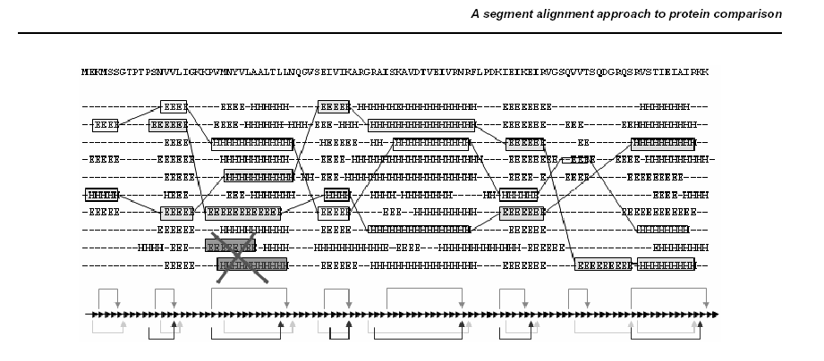
Alternative Approaches

Slide 36
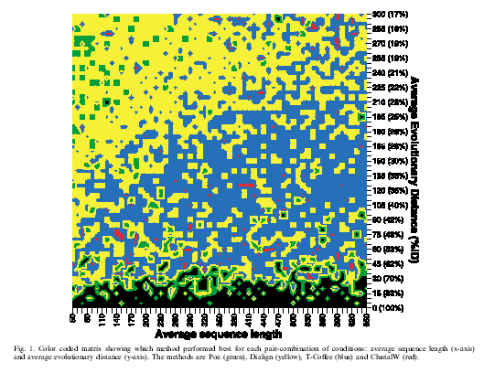
Program Performance
Source: Lassmann & Sonnhammer (2002)

Slide 37
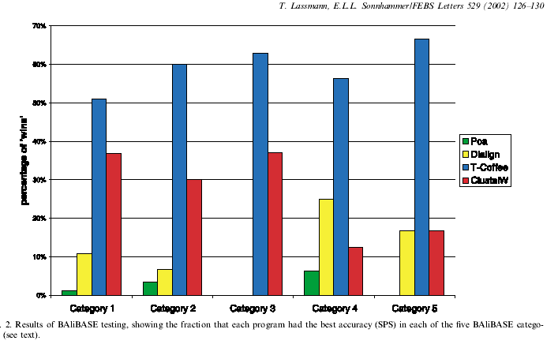
Alignment Accuracy
Source: Lassmann & Sonnhammer (2002)

